Slide 1
Real-Time Rendering of Ocean Water With Dynamic Skybox
Aaron Hornby

Slide 2
GOALS
Implement a real-time simulation of ocean water/waves in a photorealistic manner.
Implement a dynamic skybox and environment that influences water shading.
Provide a well-documented open source repository for others seeking to learn the techniques.
Provide a sandbox environment with many tweakable parameters to influence both water mesh representation and visuals.
Multi-platform.

Slide 3
Motivation
Prevalent topic, important appeal.
Every water renderer is different.
Many subtleties that can be modified to get different looks.

Slide 4
The Challenge (water)
Infinite surface – broad representation (requires LOD scheme), must move with the camera.
Multiple surface properties (amplitude, frequency, speed, steepness, direction).
Smaller scale noise for a more refined look.
Shading is a composition of many layers (tint, clarity, edge smoothing, local reflections, local refractions, global reflections, Fresnel reflectance, sun specular highlight, fog, distortion, ambient light, etc.).
Reduce amount of visual tiling / repetition.
Knowing when to stop?

Slide 5
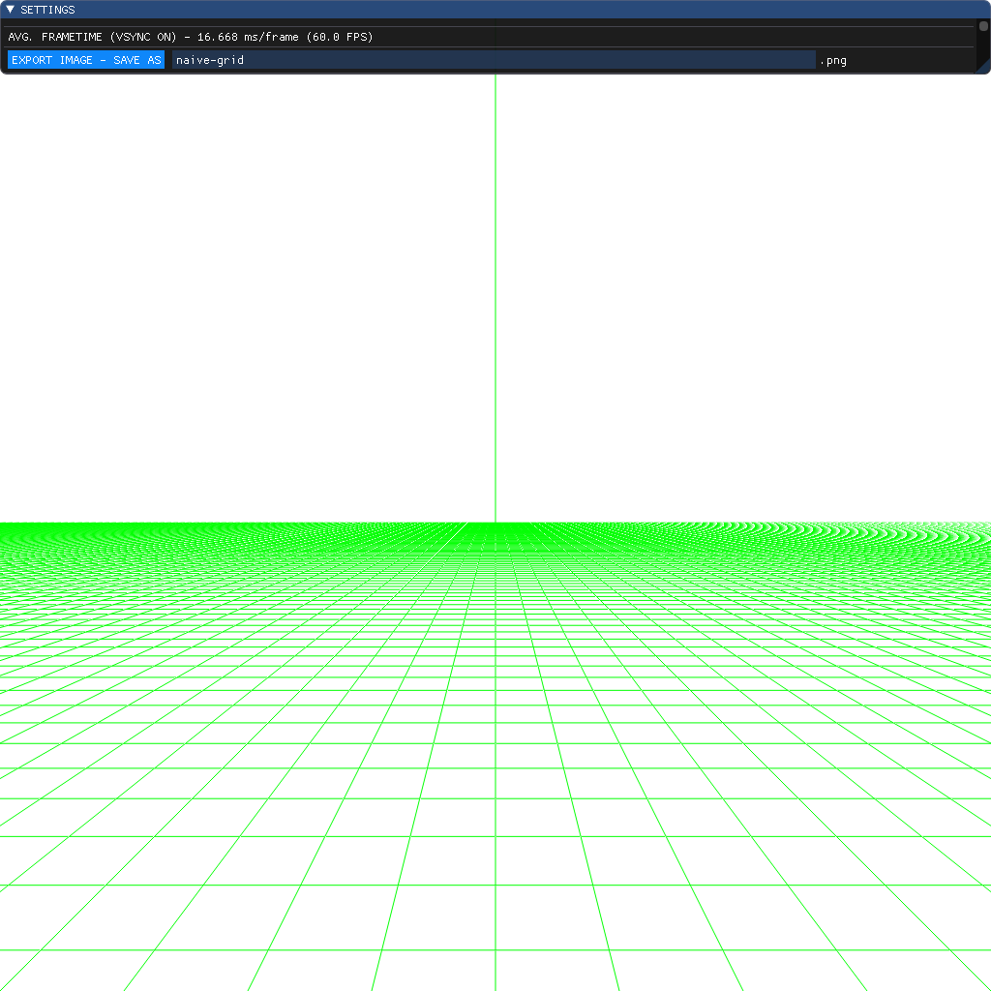
Surface Representation (naïve approach)
Construct a planar grid along the XZ-plane in our scene, with equally distributed points in world-space.
Problems?
How do you represent an infinite surface that spans towards horizon?
High close-detail means subdividing the entire grid, must of which is far away or offscreen (low vertex efficiency).
Visual artifacts farther away.

Slide 6
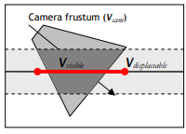
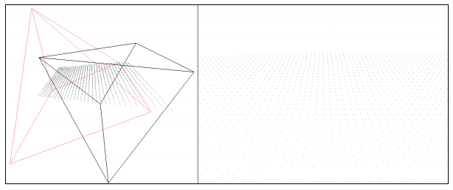
The Projected Grid Concept (the solution)
Claes Johanson, “Real-time water rendering – Introducing the projected grid concept” [2004].
XZ-planar grid fit into camera frustum, pseudo-LOD, roughly equal distribution of grid points in post-perspective space.
Relatively simple to implement versus other LOD schemes.
Problems? Mainly the “swimming artifacts”. Less relevant for water that naturally “swims”.

Slide 7
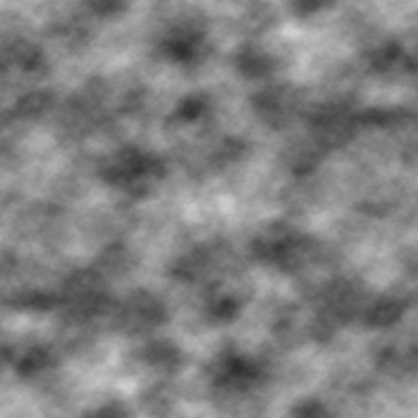
First Attempt (Heightmap)
Sample a grayscale noise texture (the heightmap) and displace only the world-space grid points in the +y axis.
Simple, but tiling is an eyesore.
Not suitable for waves that require crests to be steeper.
No directionality unless baked into heightmap and animated.

Slide 8
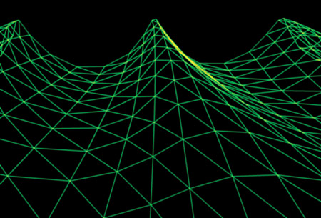
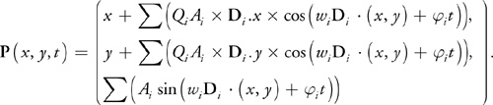
Second attempt (Gerstner Waves)
Mark Finch, Cyan Worlds, “Chapter 1. Effective Water Simulation from Physical Models”. Nvidia GPU Gems. 5th Printing, September, 2007.
Displacement of grid points in XYZ/
Amplitude, Frequency, Phase Constant (~Speed), Steepness, Direction.

Slide 9
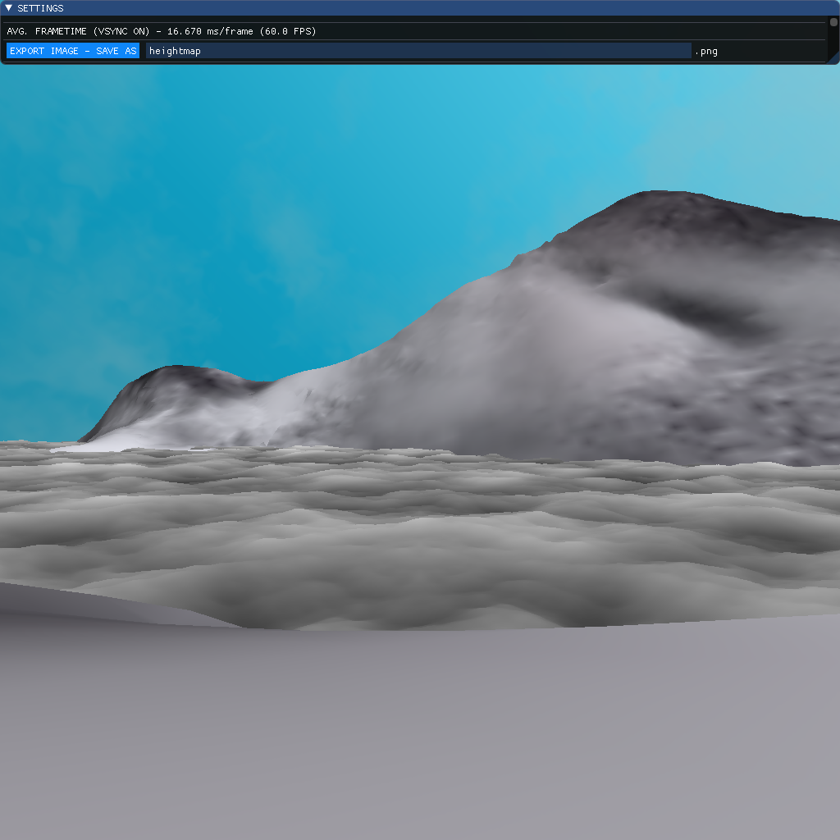
Heightmap (randomness)
Two adjustable parameters: “roughness and steepness”.

Slide 10
Overview of the shading
A composition of many layers with distortion:
Transmission Colour = {tint, refraction, clarity, depth}.
Reflection Colour = {global/skybox, sun highlight, local}.
colour = vec4(mix(waterFresneTransmissionColour, waterFresnelReflectionColour, Fresnel_f_theta), 1.0f);
colour.a = edgeHardness;
colour.rgb = mix(colour.rgb, fogColour.rgb, fogColour.a);

Slide 11
Tint
Deep tint colour (Blue) ---> Shallow tint colour (Turquoise).
Specify both colours at noon (brightest) which then automatically fade to black as sun lowers in sky.
User parameter in [0.0, 1.0].

Slide 12
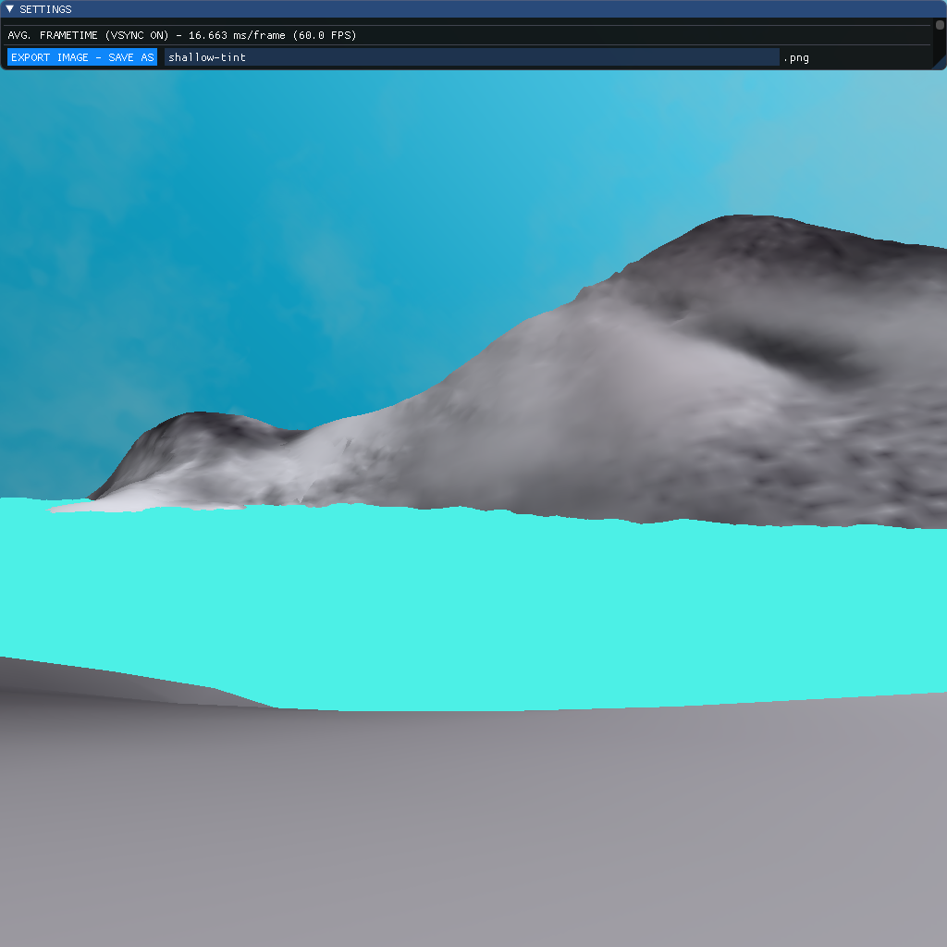
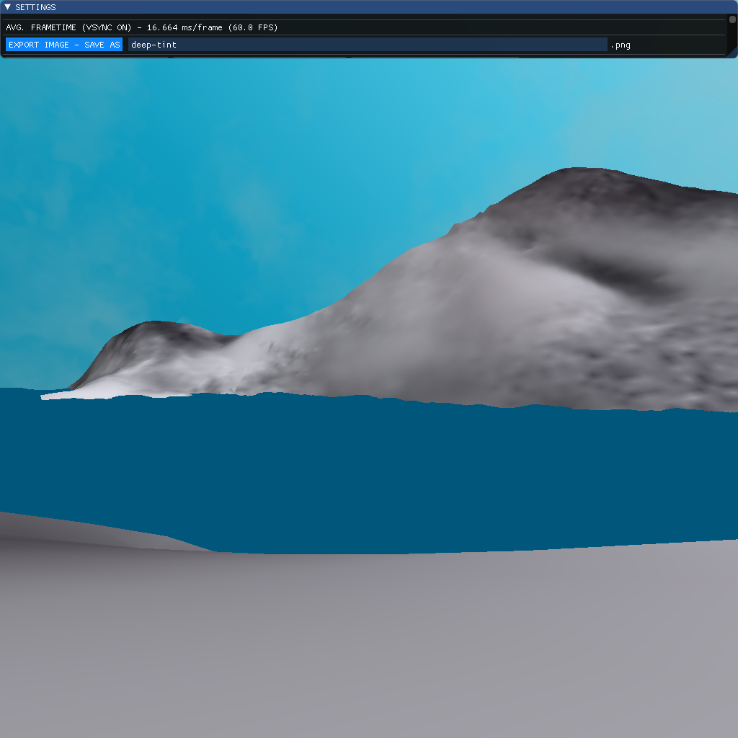
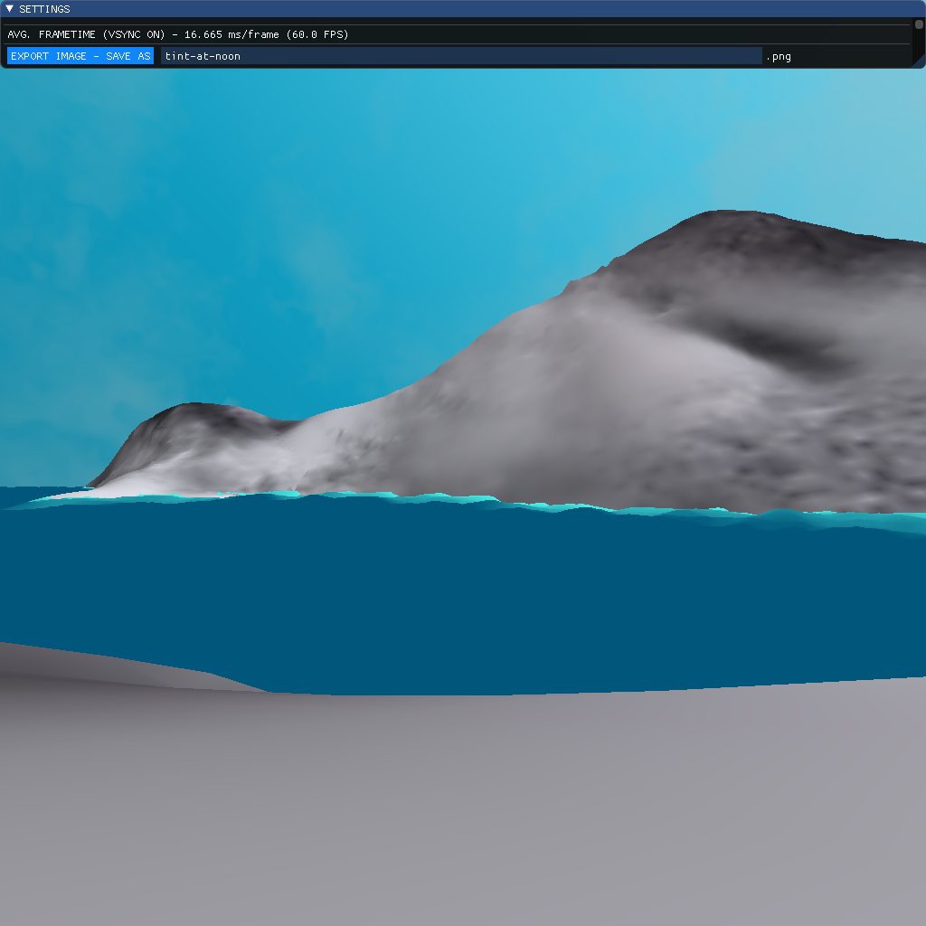
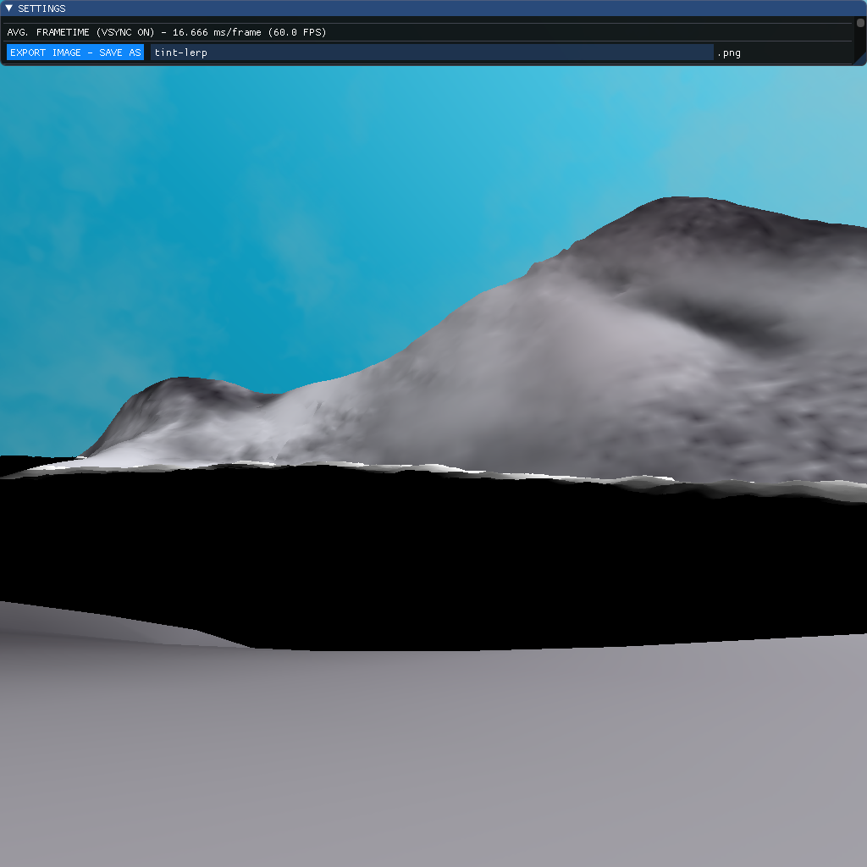
Tint (cont.)

Slide 13
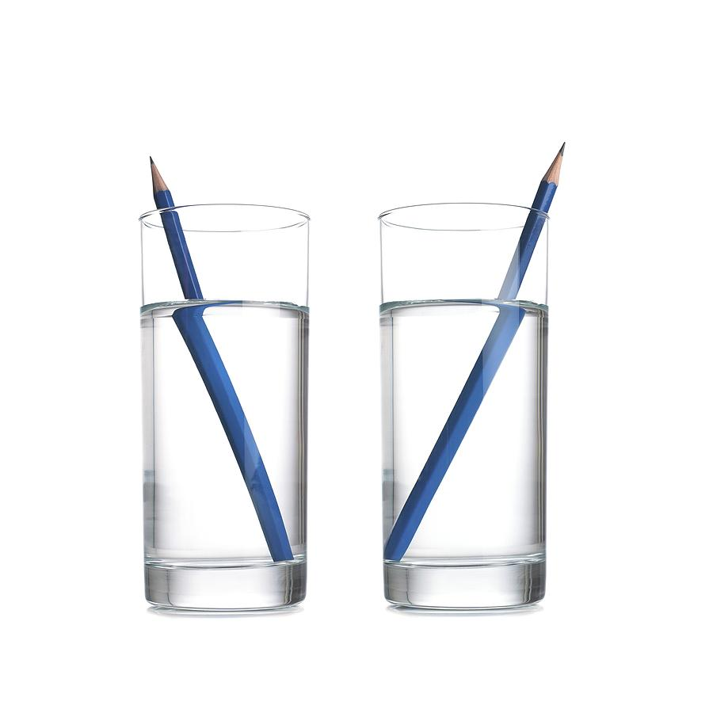
Local Refractions
Render scene to texture
Render geometry with world-space position.y at 75% (n_air = 1.0003 / n_water = 1.33)
Clip plane at XZ-plane (leaves geometry below plane)
Enable back-face culling with standard winding (counter-clockwise) – avoid higher geometry now occluding your view.
Problems? Approximating the surface with a plane means that larger error when amplitude increases. Noticeable at intersections, but will be hidden by other effects (foam, soft edges)

Slide 14
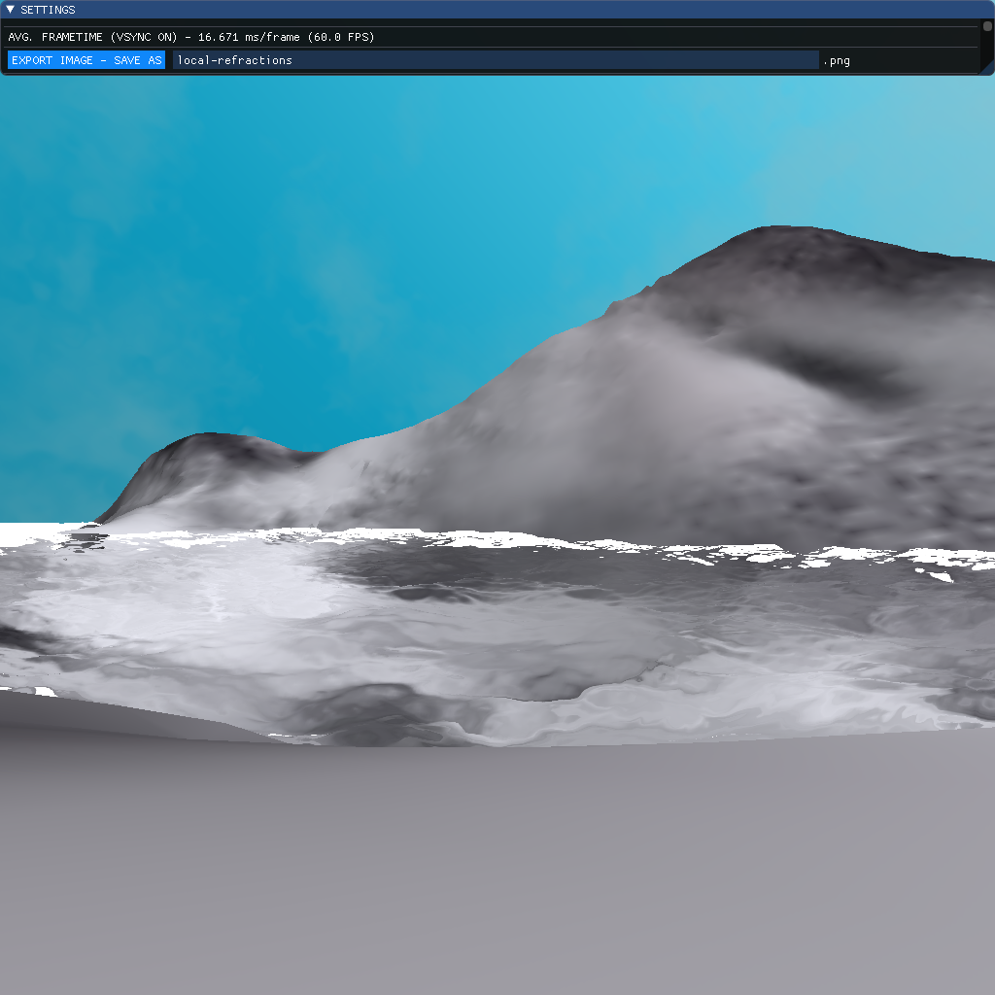
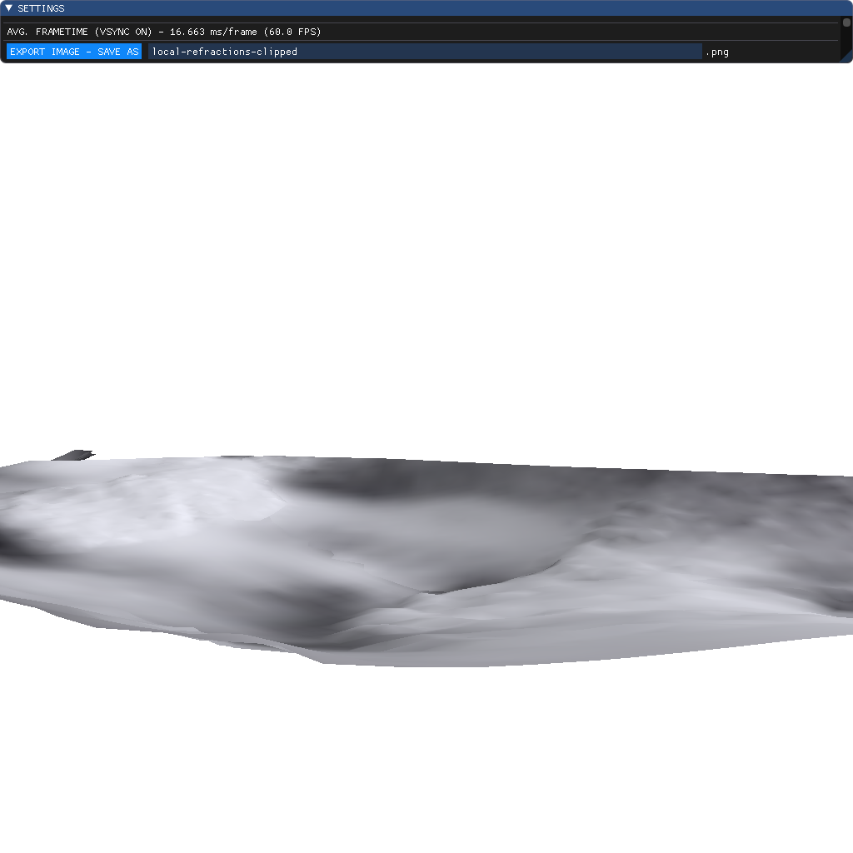
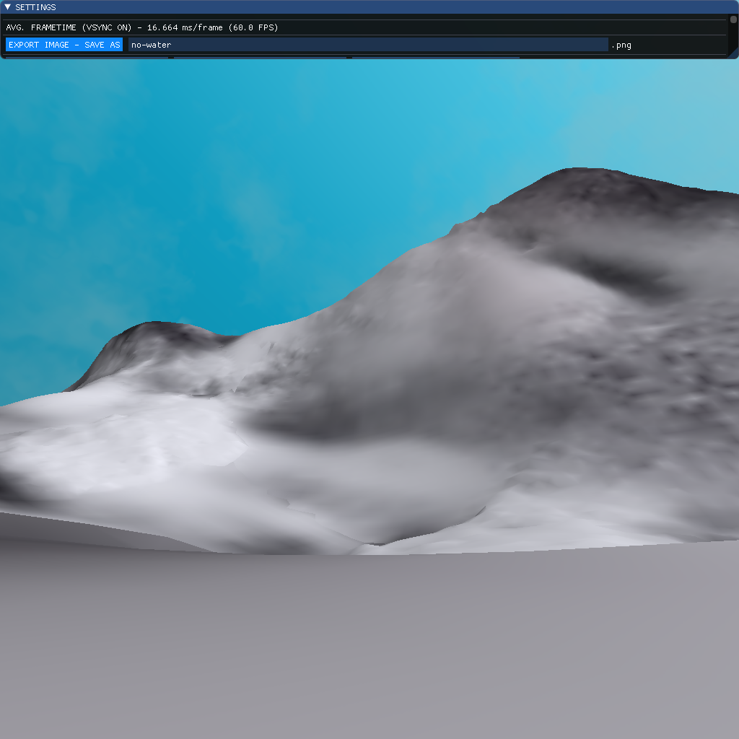
Local Refractions (cont.)

Slide 15
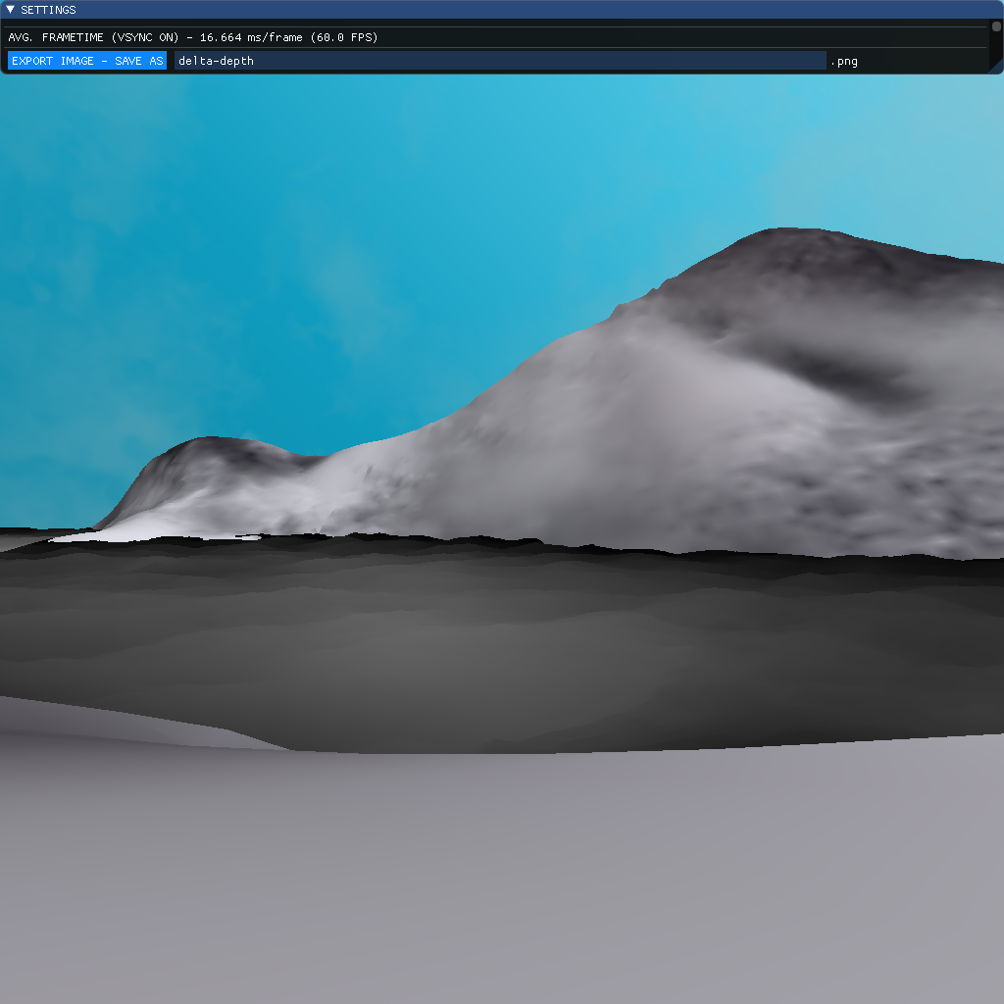
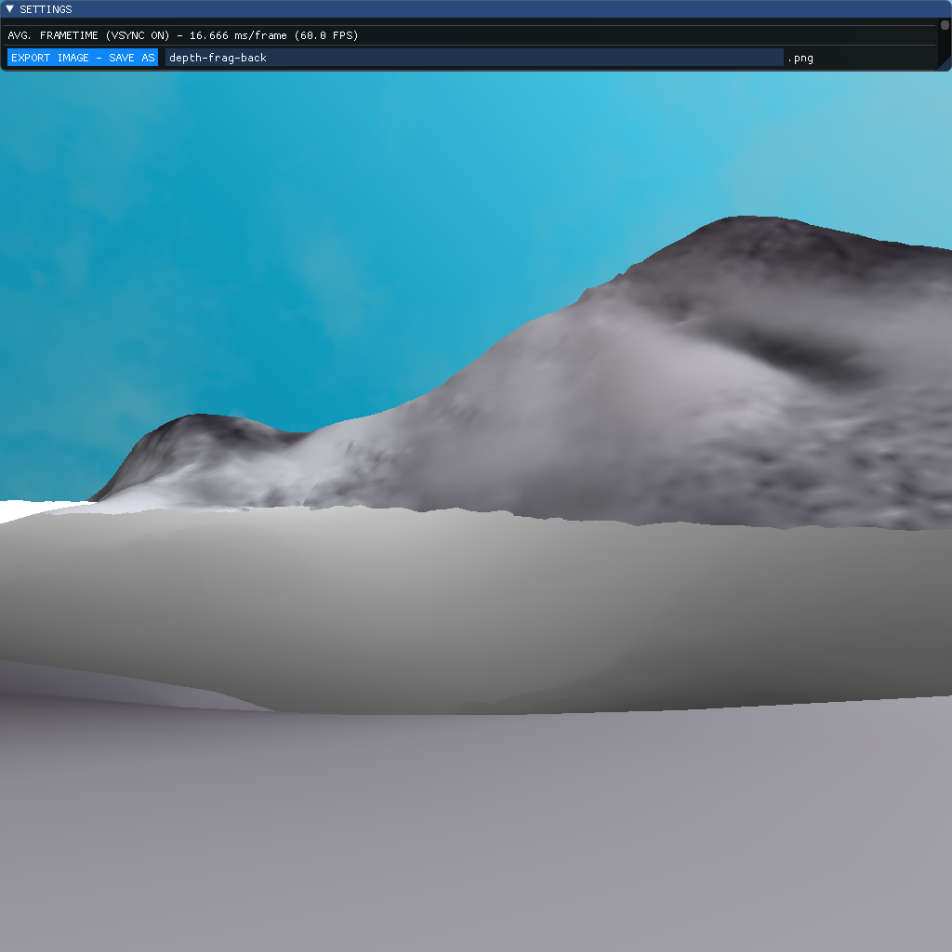
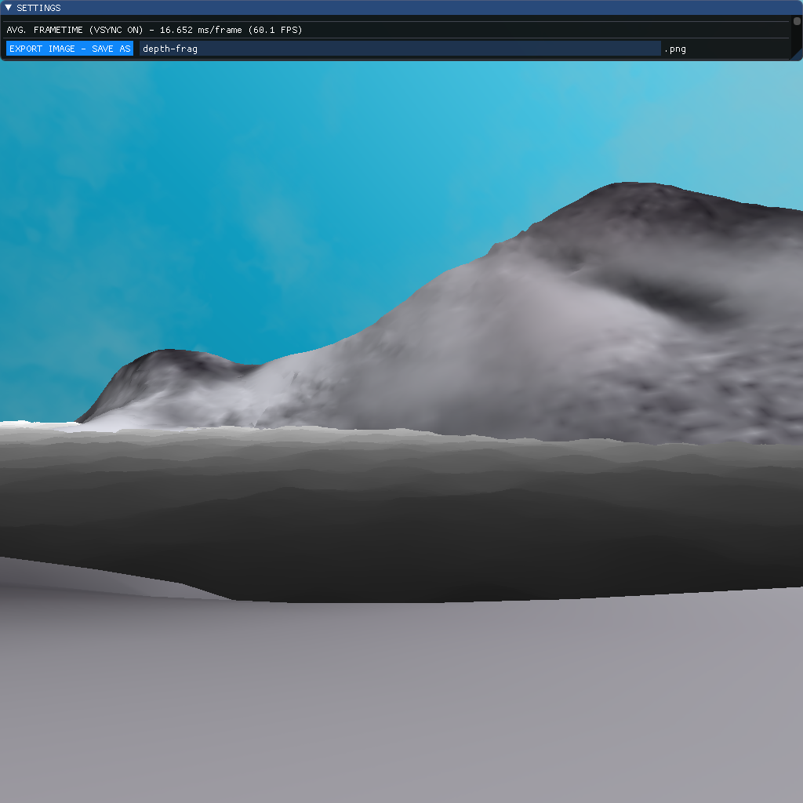
Depth & Clarity
Depth used for many effects.
Important notice: make sure to take advantage of the full 24-bit depth buffer precision when performing comparison. Otherwise, you end up with larger colour bands and some jagged edges.
User parameter (multiplier of the depth delta – how far into water can we see refractions).

Slide 16
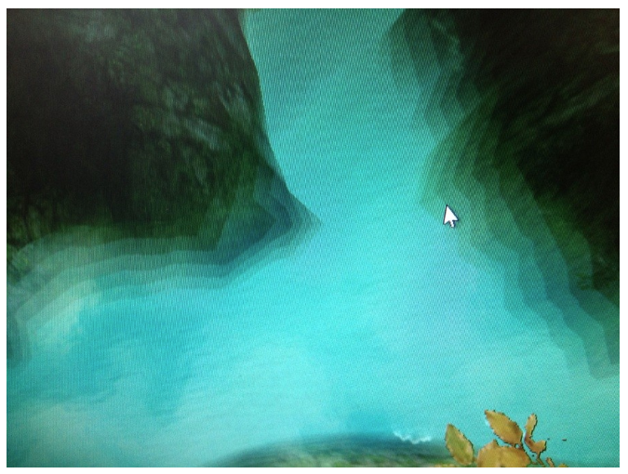
Pitfall – early discretization

Slide 17
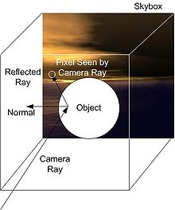
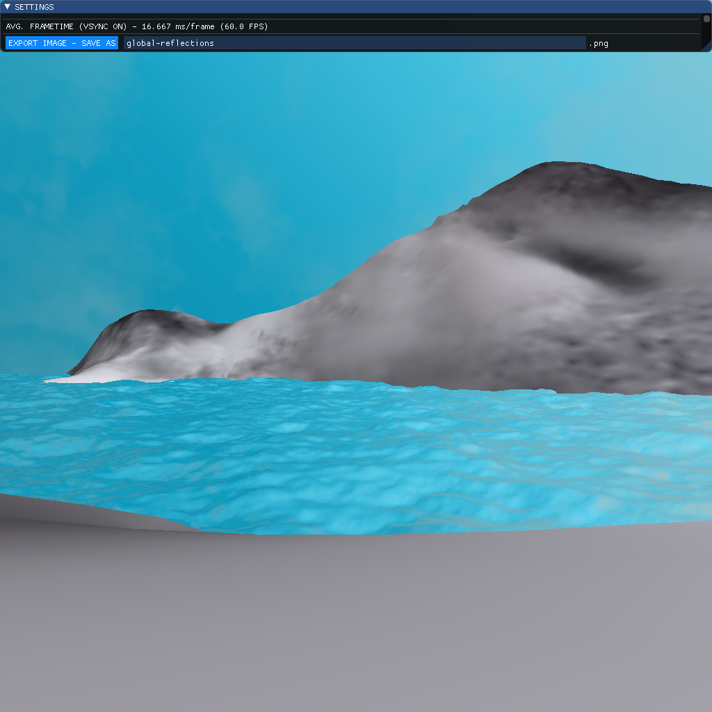
Global Reflections
Simple skybox mapping.

Slide 18
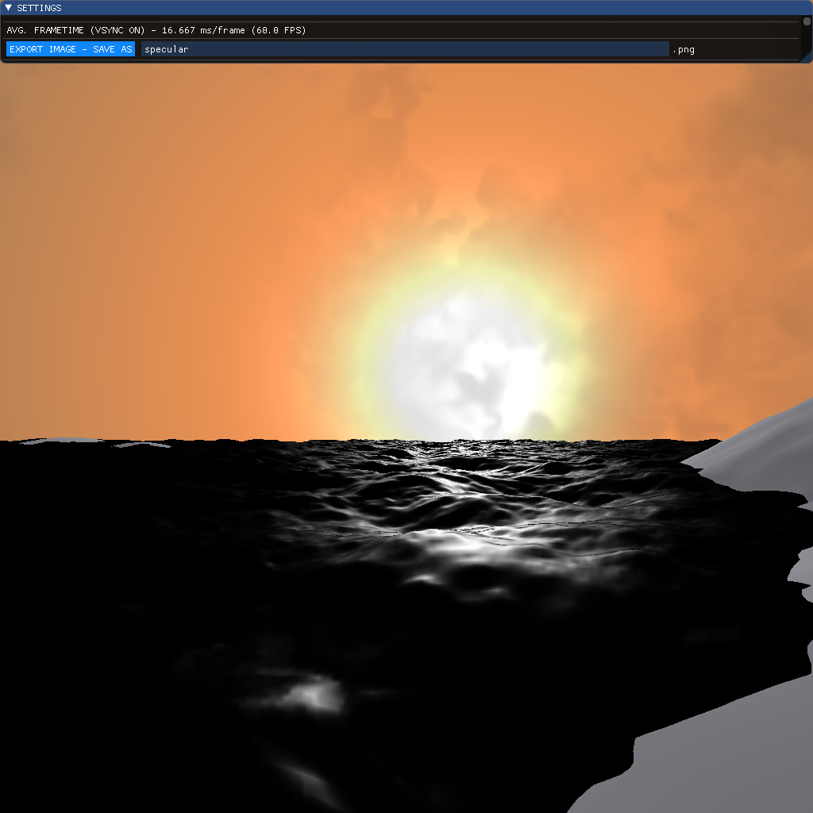
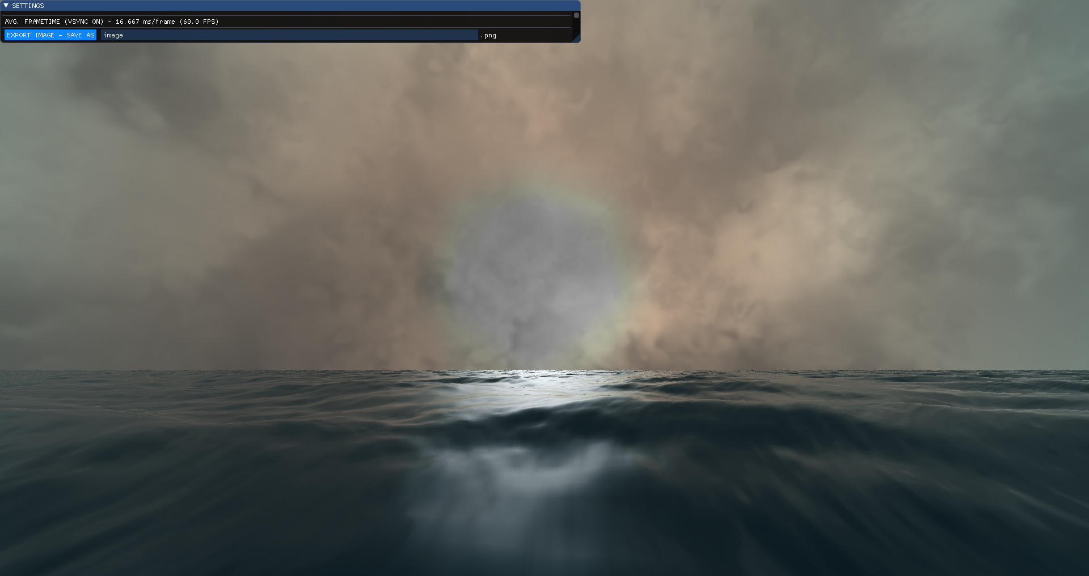
Sun (Specular Highlight)
Employs the same specular highlight formula as skysphere.

Slide 19
Local reflections
Render scene to texture.
Apply a mirror matrix that flips the y-component of the world-space position, since our reflection plane is the XZ-plane.
Clip plane at XZ-plane (leaves geometry below plane).
Enable back-face culling with reversed winding (clockwise) – avoid lower geometry now occluding your view.
Problems? Approximating the surface with a plane means that larger error when amplitude increases. Noticeable at intersections, but will be hidden by other effects (e.g. soft edges).

Slide 20
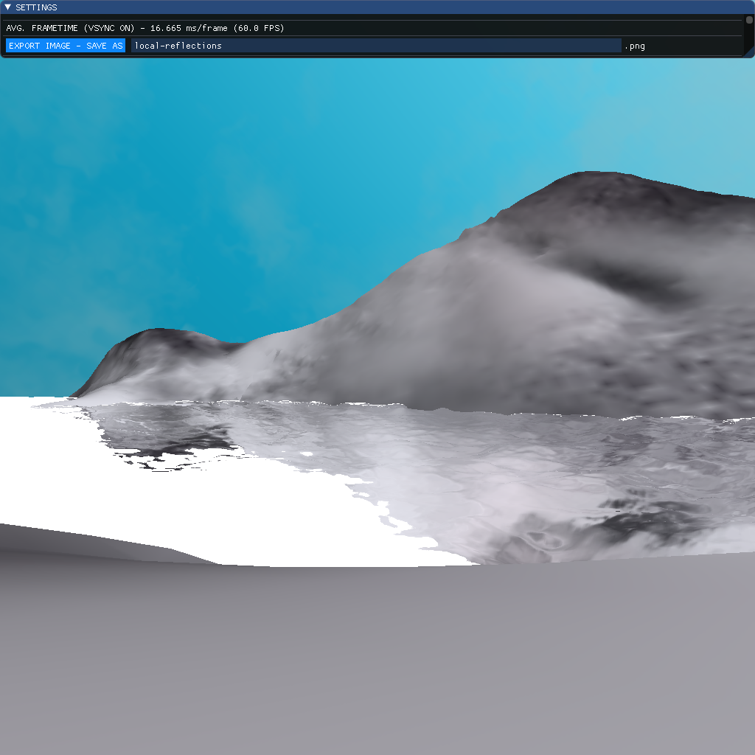
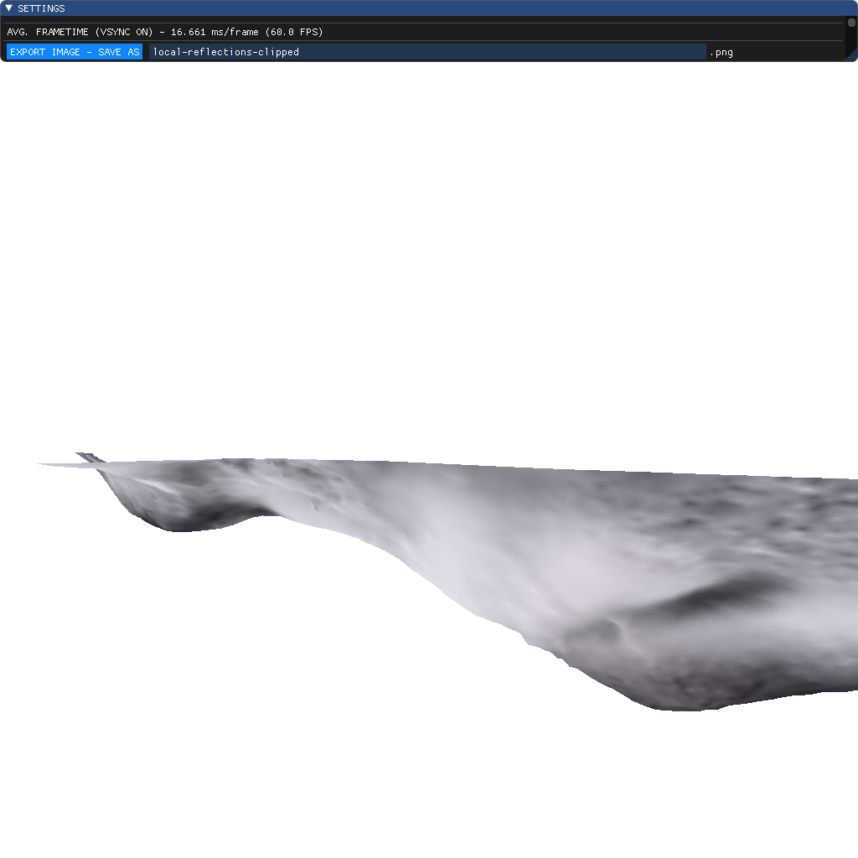
Local Reflections (cont.)

Slide 21
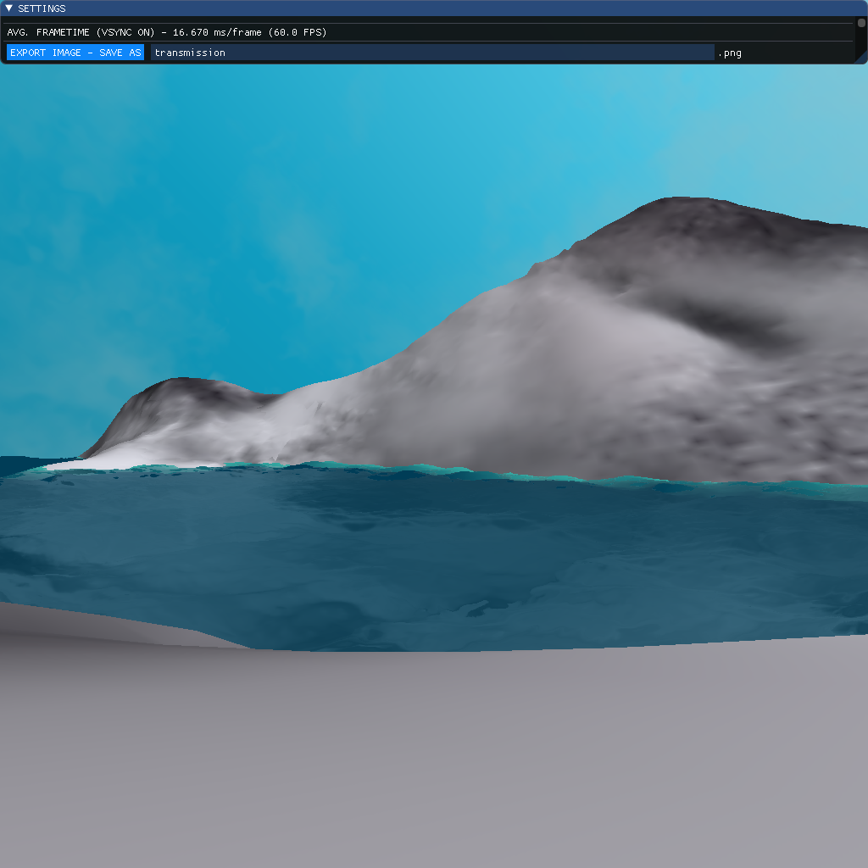
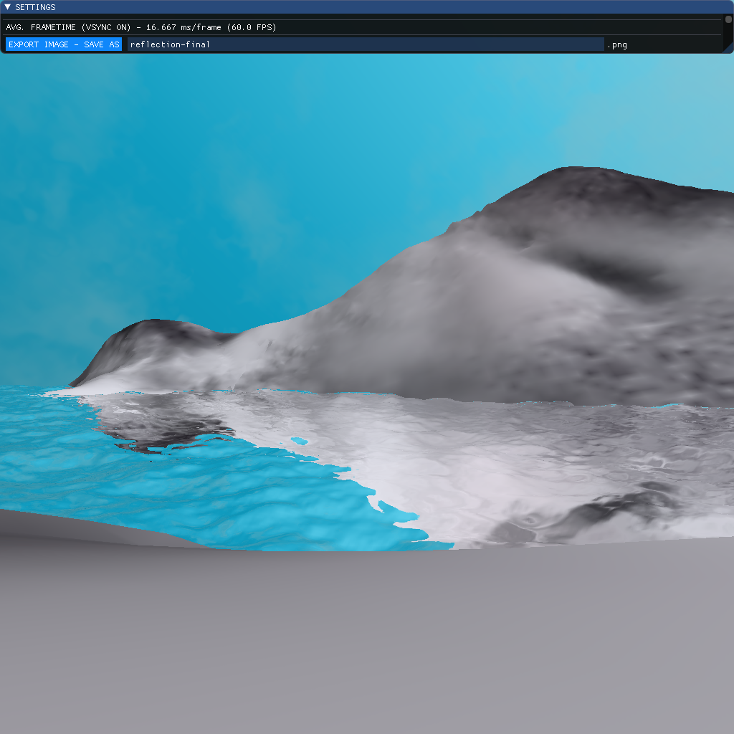
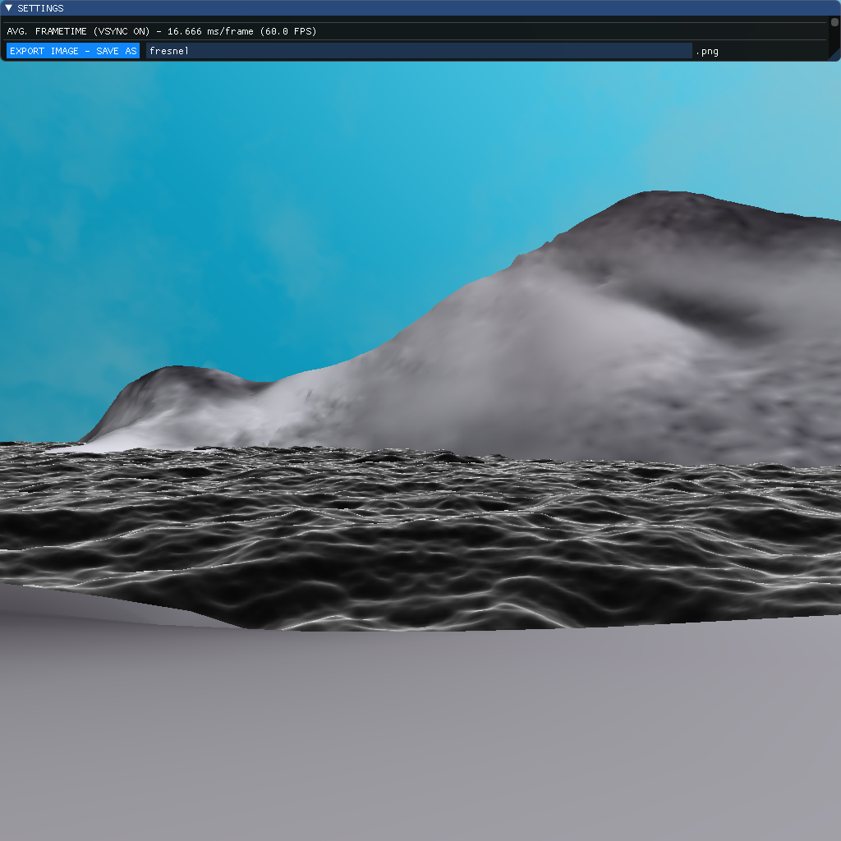
Fresnel Reflectance (final composition)

Slide 22
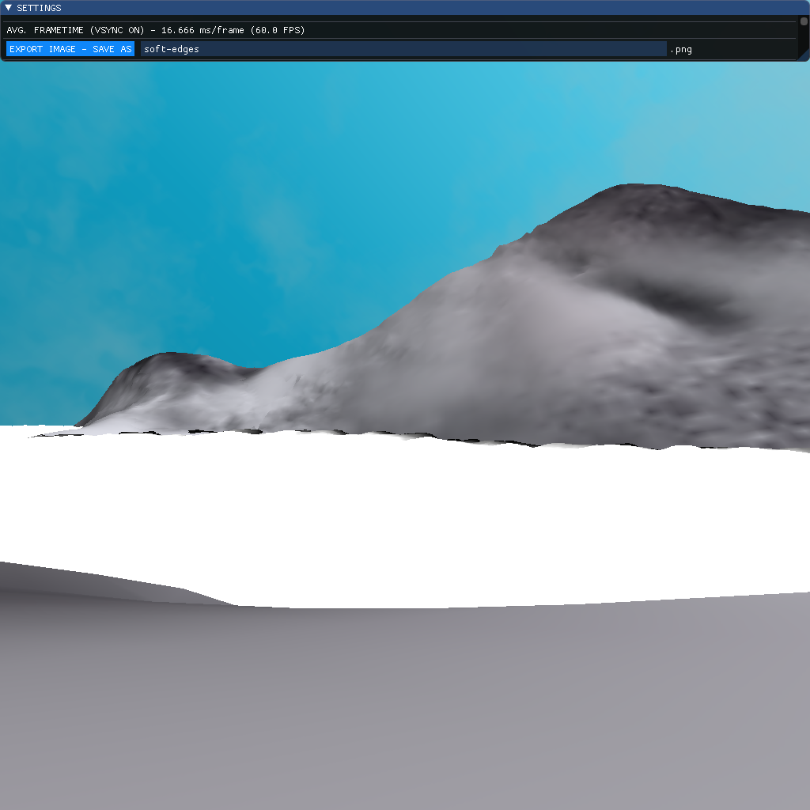
Soft-Edges

Slide 23
Future Work
Underwater effects (light attenuation, shallow caustics)
Boat wakes
Shoreline “wetting”
Cheap “particle splashing” on contact with steep shores / rocks
More realistic skybox (animated clouds, flatter look)
Apply dithering technique to reduce visible colour banding everywhere in gradients
Deferred-rending / G-buffers
Better animation
Buoyancy / rocking in water

